Slide 2
JUnit 5 is a software testing framework used by developers to unit test their code. It is a Java-based framework that allows writing and running tests on the Java platform, including an integrated reporter that displays the test results.
JUnit can be used for automation testing for two main purposes:
Test that the software is working as it is expected to work
Find and report errors in the code and fix them as quickly as possible

Slide 3
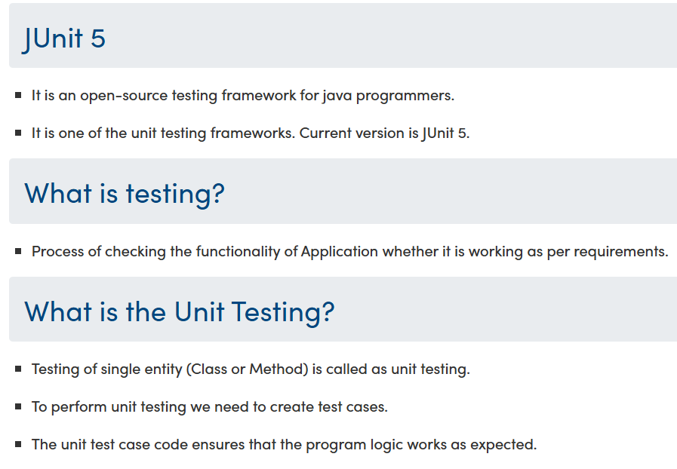

Slide 4
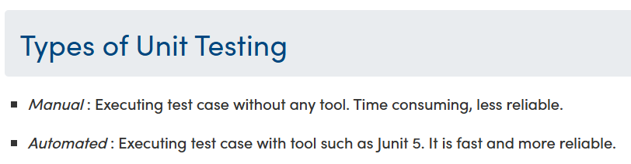

Slide 5
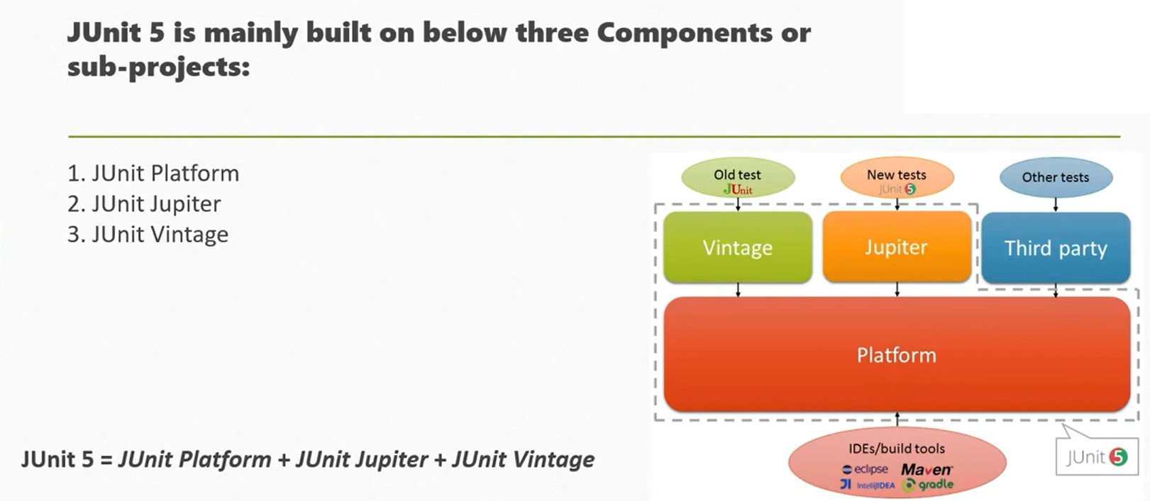

Slide 6
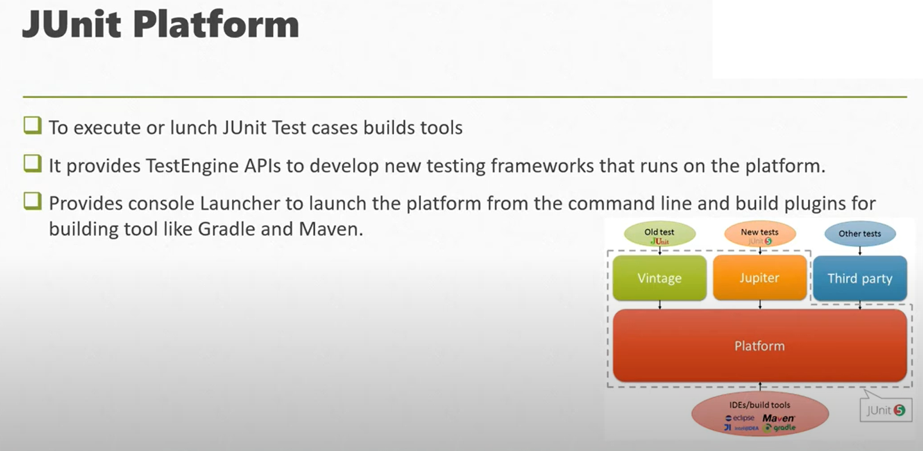

Slide 7


Slide 9


Slide 10
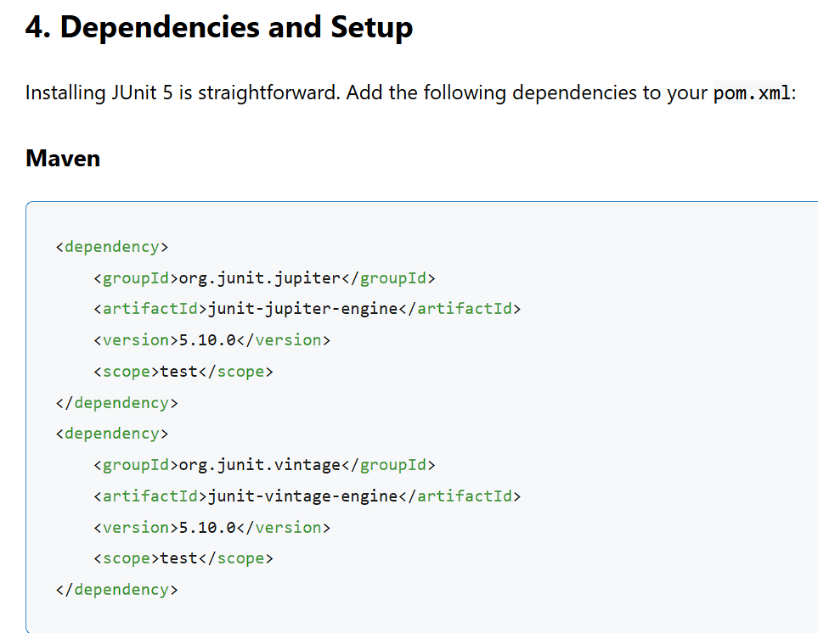


Slide 11
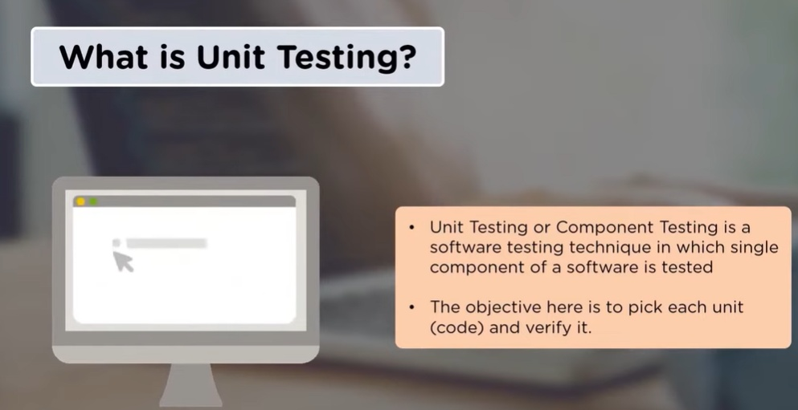

Slide 12
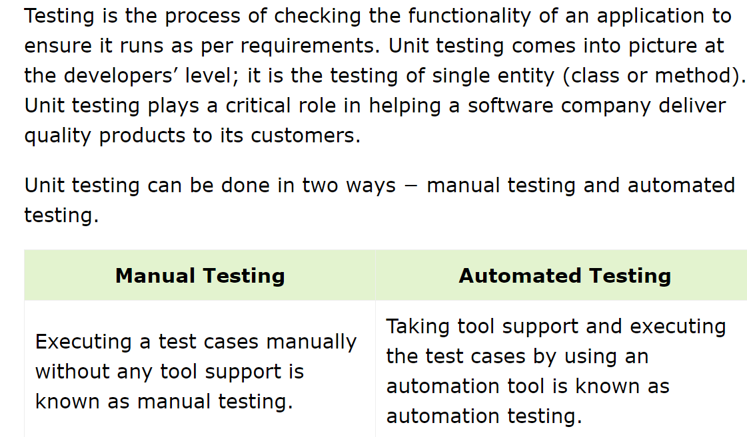

Slide 13
JUnit is a unit testing framework for the Java programming language. JUnit has been important in the development of test-driven development, and is one of a family of unit testing frameworks which is collectively known as xUnit that originated with SUnit.

Slide 14
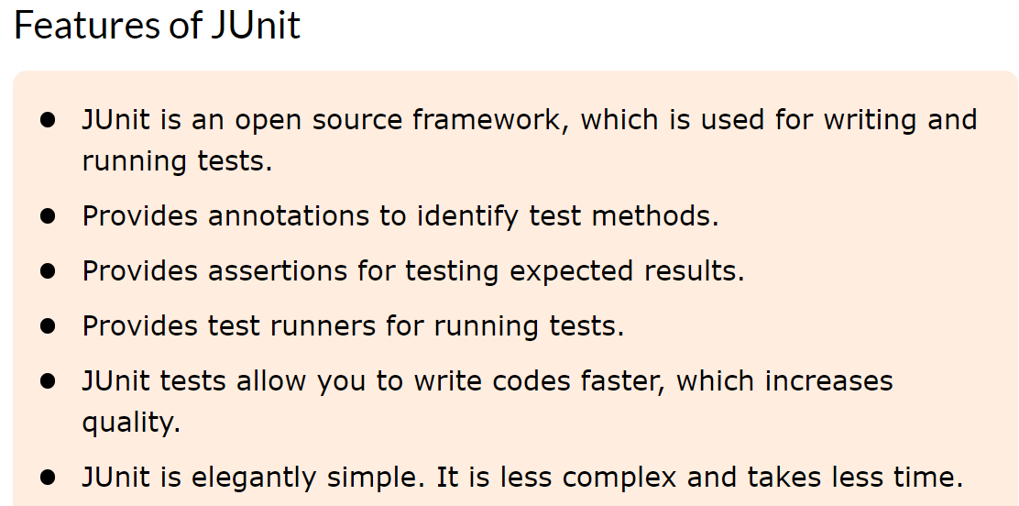

Slide 15
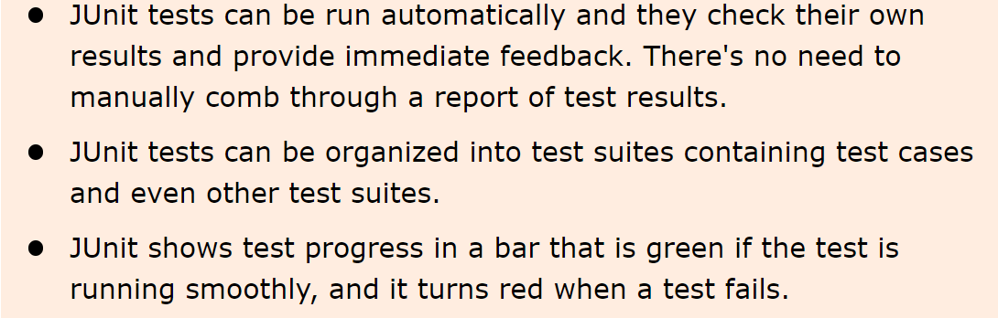

Slide 16
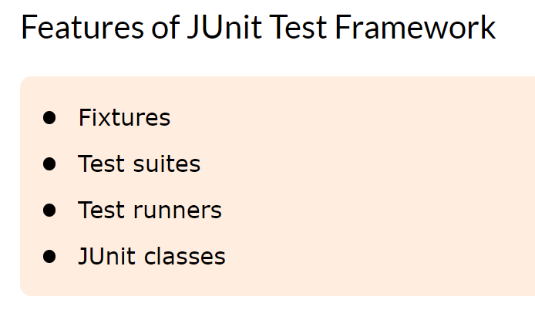

Slide 17
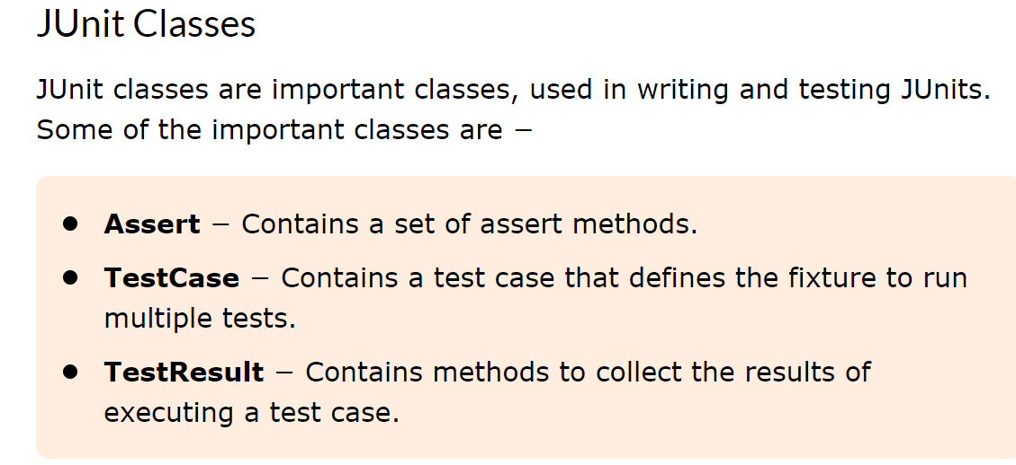

Slide 18
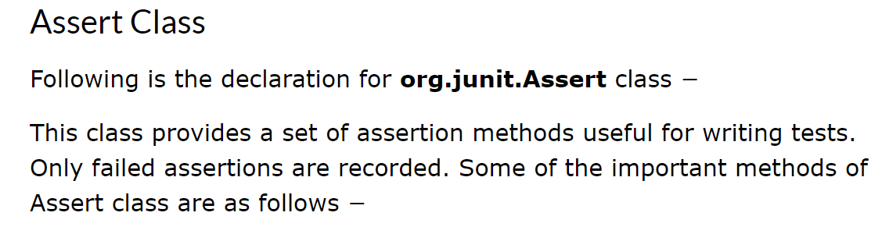

Slide 19
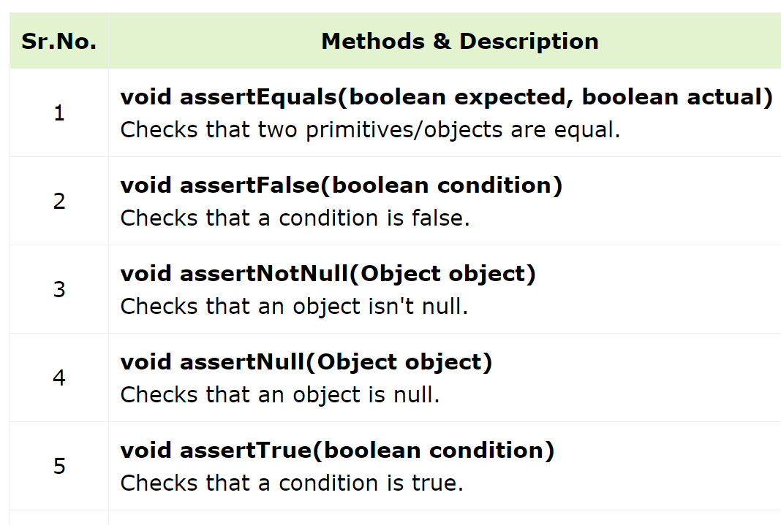

Slide 21
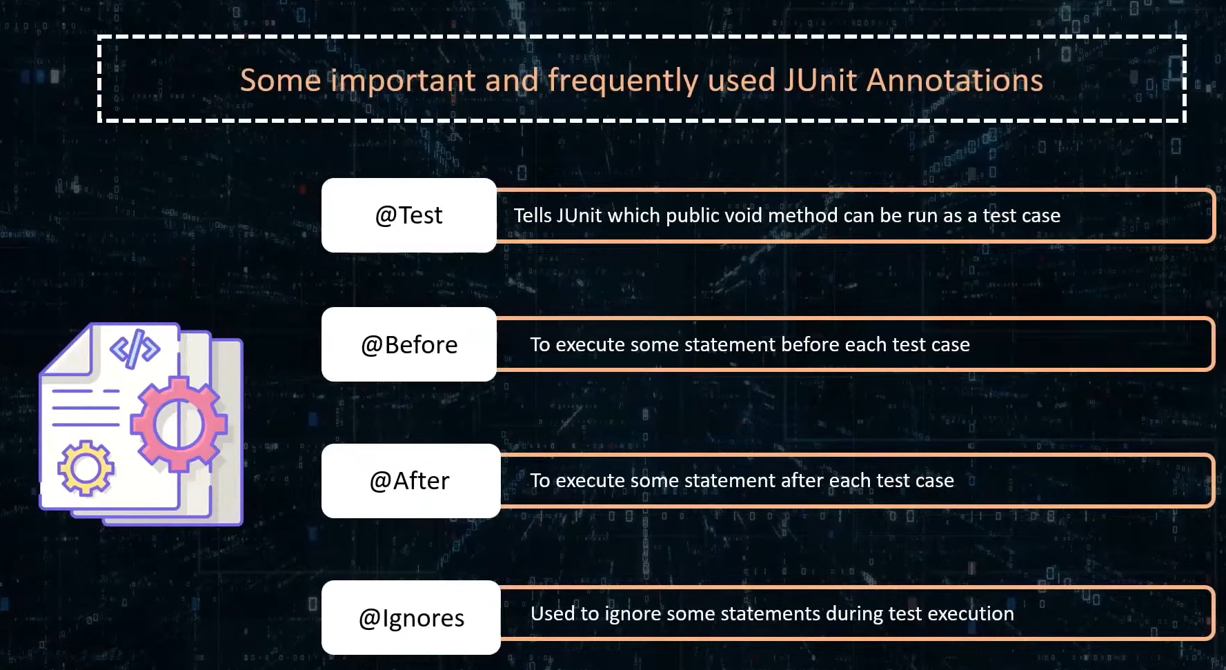

Slide 22
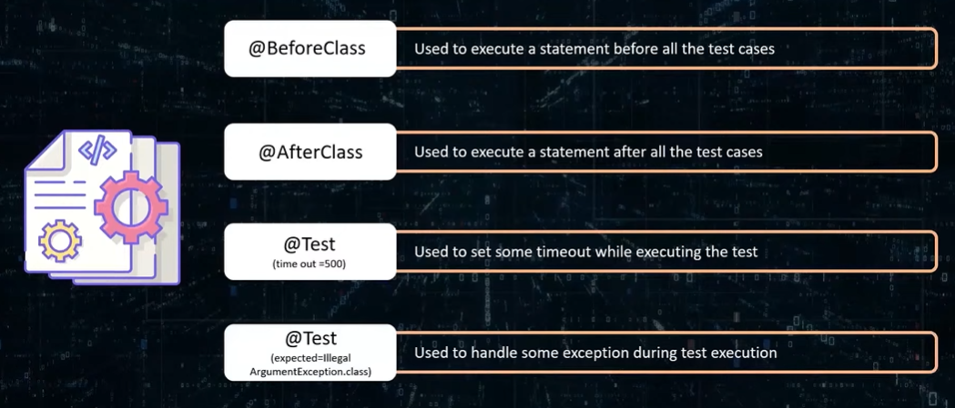

Slide 24
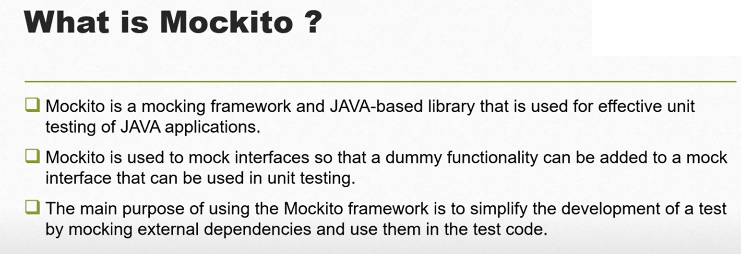

Slide 25
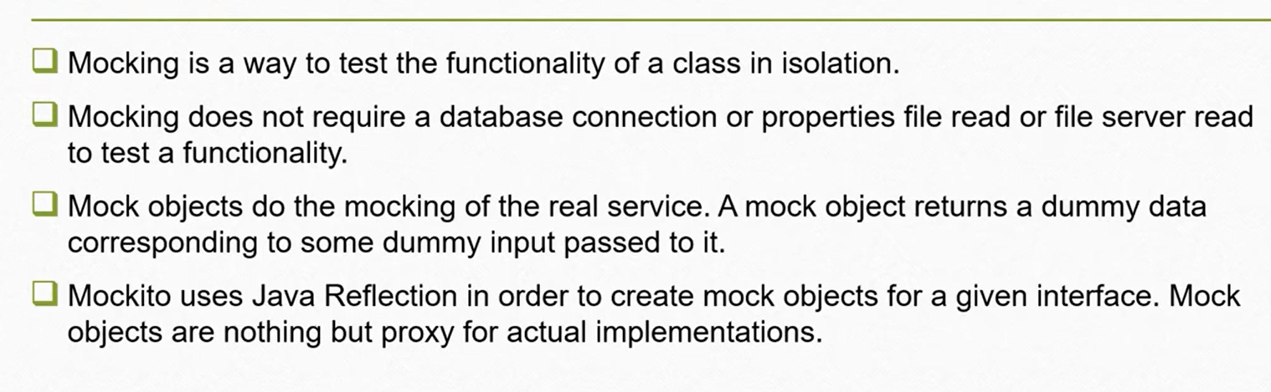

Slide 26
How to create Mocks in Mockito?
Using @Mock annotation
Using Mock() method
is available in the org.mockito package.

Slide 27
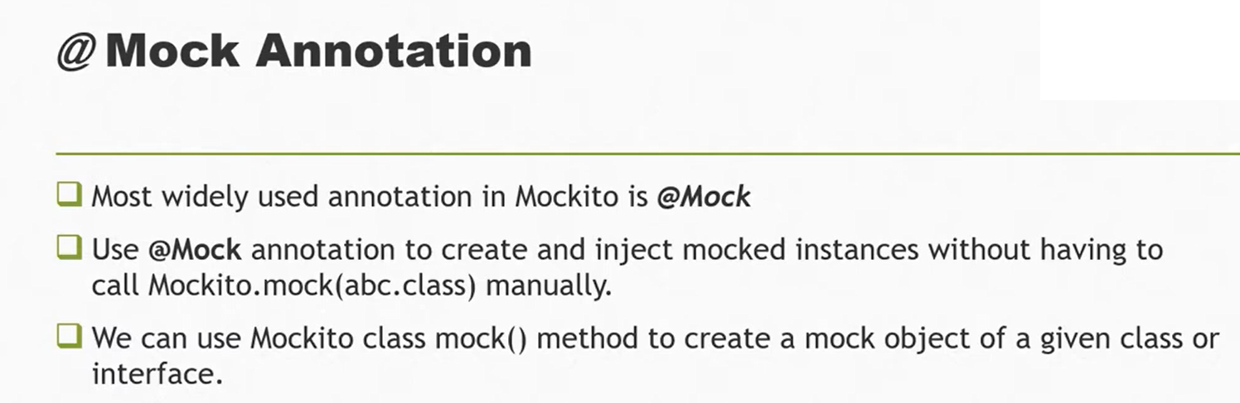

Slide 28
